Slide 1
Predicting Heart Disease
Srikar Nadella & Ronit Malhotra
Notes:
Ronit

Slide 2
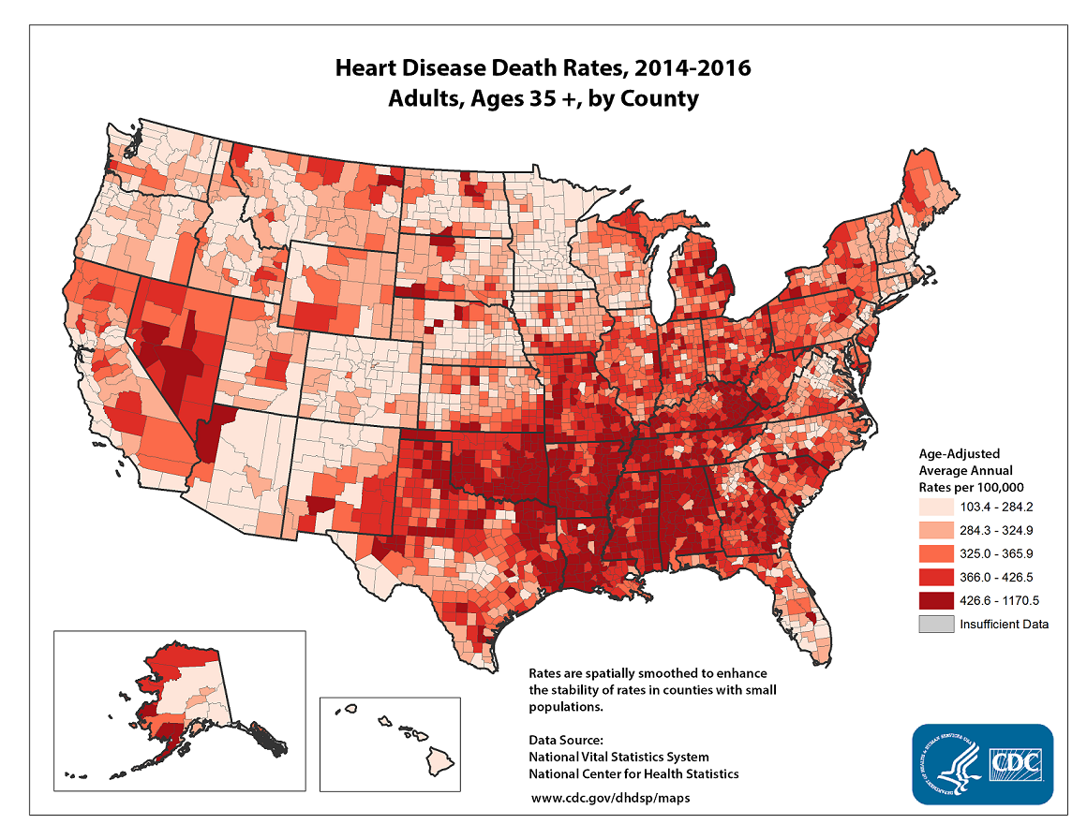
Notes:
Ronit

Slide 3
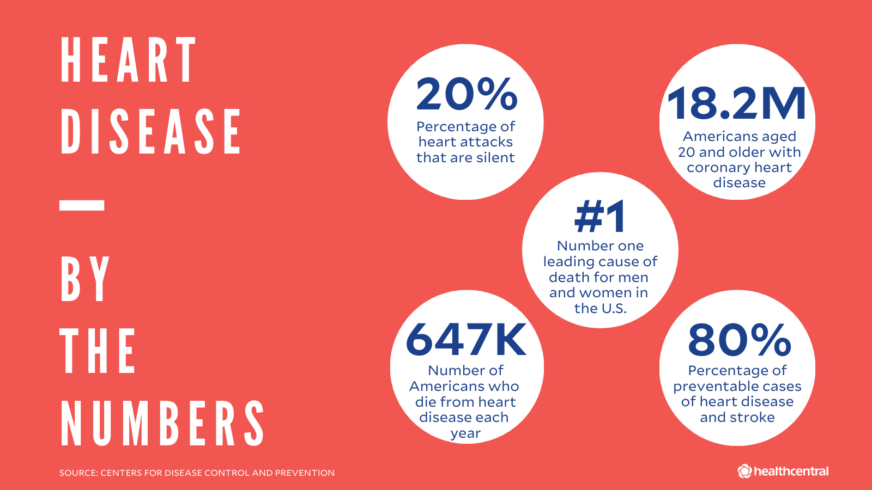

Slide 4

https://www.kaggle.com/ronitf/heart-disease-uci
Notes:
Ronit

Slide 5
Features
Age
Sex (gender)
Chest pain type (on a scale of 0 - 3)
Resting blood pressure
Serum cholesterol in mg/dl
Fasting blood sugar > 120 mg/dl
Maximum heart rate achieved
Exercise induced angina
Number of major vessels (0-3) colored by fluoroscopy
Notes:
Ronit
Heart Disease Data Dictionary
The following are the features we'll use to predict our target variable (heart disease or no heart disease).
age - age in years
sex - (1 = male; 0 = female)
cp - chest pain type
0: Typical angina: chest pain related decrease blood supply to the heart
1: Atypical angina: chest pain not related to heart
2: Non-anginal pain: typically esophageal spasms (non heart related)
3: Asymptomatic: chest pain not showing signs of disease
trestbps - resting blood pressure (in mm Hg on admission to the hospital)
anything above 130-140 is typically cause for concern
chol - serum cholestoral in mg/dl
serum = LDL + HDL + .2 * triglycerides
above 200 is cause for concern
fbs - (fasting blood sugar > 120 mg/dl) (1 = true; 0 = false)
Blood sugar usually after an overnight fast
thalach - maximum heart rate achieved
exang - exercise induced angina (1 = yes; 0 = no)
ca - number of major vessels (0-3) colored by flourosopy
colored vessel means the doctor can see the blood passing through
the more blood movement the better (no clots)

Slide 6
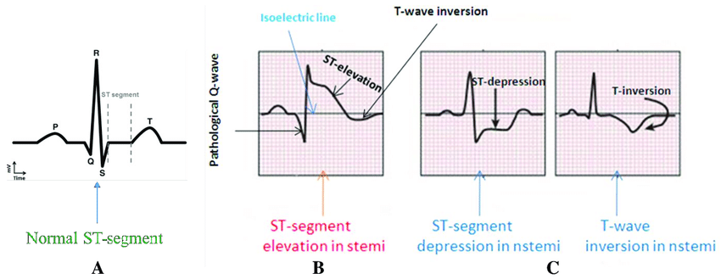
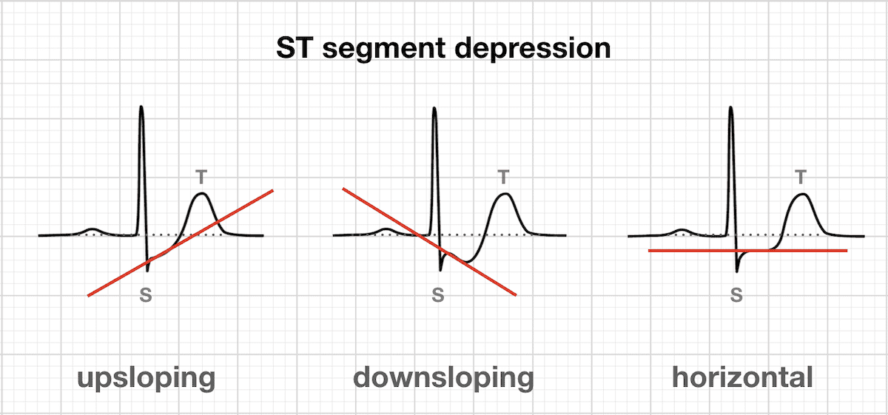
Features continued
Resting electrocardiographic results (values 0,1,2)
Oldpeak = ST segment depression induced by exercise relative to rest
The slope of the peak exercise ST segment(0,1,2)
Notes:
Electrocardiogram: Measures electric signals in heart, often used to detect abnormal heart rhythms
restecg - resting electrocardiographic results
0: Nothing to note
1: ST segment abnormality
can range from mild symptoms to severe problems
signals non-normal heart beat
2: Possible or definite left ventricular hypertrophy
Enlarged heart's main pumping chamber
oldpeak - ST segment depression induced by exercise relative to rest
looks at stress of heart during excercise
unhealthy heart will stress more
slope - the slope of the peak exercise ST segment
0: Upsloping: better heart rate with excercise (uncommon)
1: Flatsloping: minimal change (typical healthy heart)
2: Downsloping: signs of unhealthy heart

Slide 7
Age | Sex | Chest Pain | Rest Blood Pressure | Cholesterol | Fasting Blood sugar | Resting ECG | Max heart rate | Angina | oldpeak | slope | ca | Target
63 | 1 | 3 | 145 | 233 | 1 | 0 | 150 | 0 | 2.3 | 0 | 0 | 1
37 | 1 | 2 | 130 | 250 | 0 | 1 | 187 | 0 | 3.5 | 0 | 0 | 1
41 | 0 | 1 | 130 | 204 | 0 | 0 | 172 | 0 | 1.4 | 2 | 0 | 1
65 | 1 | 0 | 120 | 177 | 0 | 1 | 140 | 0 | 0.4 | 2 | 0 | 1
56 | 1 | 1 | 120 | 236 | 0 | 1 | 178 | 0 | 0.8 | 2 | 0 | 1
57 | 0 | 0 | 120 | 354 | 0 | 1 | 163 | 1 | 0.6 | 2 | 0 | 1
57 | 1 | 0 | 140 | 192 | 0 | 1 | 148 | 0 | 0.4 | 1 | 0 | 1
56 | 0 | 1 | 140 | 294 | 0 | 0 | 153 | 0 | 1.3 | 1 | 0 | 1
Notes:
Srikar

Slide 8
Data clean
def dataClean(x,y):
#YES & NOS
x = (x[:,:])
y = (y[:,:])
x = x.astype(np.float64)
y = y.astype(np.float64)
return (x,y)
Did not change the data
Health values are unpredictable and vary
All data was numerical
No conversion necessary
Notes:
Srikar

Slide 9
Test vs. Train
def skLearning(x,y):
x_train, x_test, y_train, y_test = model_selection.train_test_split(x, y,train_size=0.75,test_size=0.25, random_state=101)
sc = StandardScaler()
x_train = sc.fit_transform(x_train)
x_test = sc.transform(x_test)
return(x_train, y_train, x_test, y_test)
Notes:
Srikar

Slide 10
Model
Input Layer
Hidden Layer
Output Layer
Batch Size
Loss Function
Epochs
Learning rate
Activation
def modelmaker(x_train,y_train,x_test,y_test):
model = models.Sequential()
model.add(layers.Dense(512, activation='relu', input_shape = (1,12) ))
model.add(layers.Dense(1024, activation='relu'))
model.add(layers.Dense(1))
model.compile(optimizer=optimizers.RMSprop(lr=0.005), loss='mse', metrics=['mae','accuracy'])
history = model.fit(x_train, y_train, epochs= 5, batch_size=5, validation_data=(x_test,y_test))
Notes:
Srikar

Slide 11
Epochs and Bits
def modelValidator(x_train,y_train,x_test,y_test, firstLayerMax, SecondLayerMax, maxNumEpochs):
firstLayer = 8
secondLayer = 8
listOfAccuracy = []
listOfAccuracyIndex = []
for numEpochs in range(maxNumEpochs):
for r in range(firstLayerMax - firstLayer):
for c in range(SecondLayerMax - secondLayer):
model = models.Sequential()
model.add(layers.Dense(np.power(2,(r + firstLayer)), activation='sigmoid', input_shape = (1,12) ))
Notes:
Srikar

Slide 12
Method Continued
model.add(layers.Dense(np.power(2,(c + secondLayer)), activation='sigmoid'))
model.add(layers.Dense(1))
model.compile(optimizer=optimizers.RMSprop(lr=0.005), loss='mse', metrics=['mae','accuracy'])
history = model.fit(x_train, y_train, epochs= numEpochs, batch_size=5, validation_data=(x_test,y_test))
test_mae_score = testData(testX, testY, model)
listOfAccuracy.append(test_mae_score[2])
listOfAccuracyIndex.append((numEpochs, r,c))
return listOfAccuracy, listOfAccuracyIndex
Notes:
Srikar

Slide 13
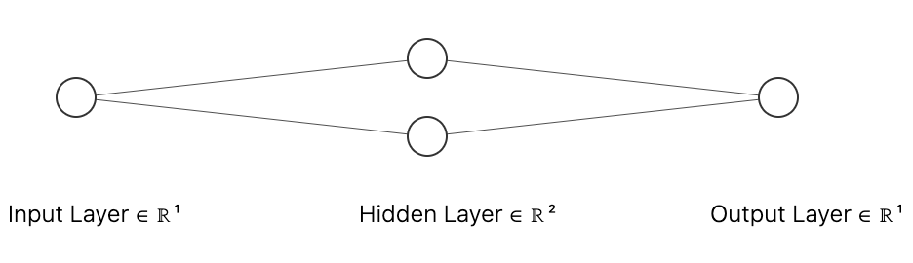
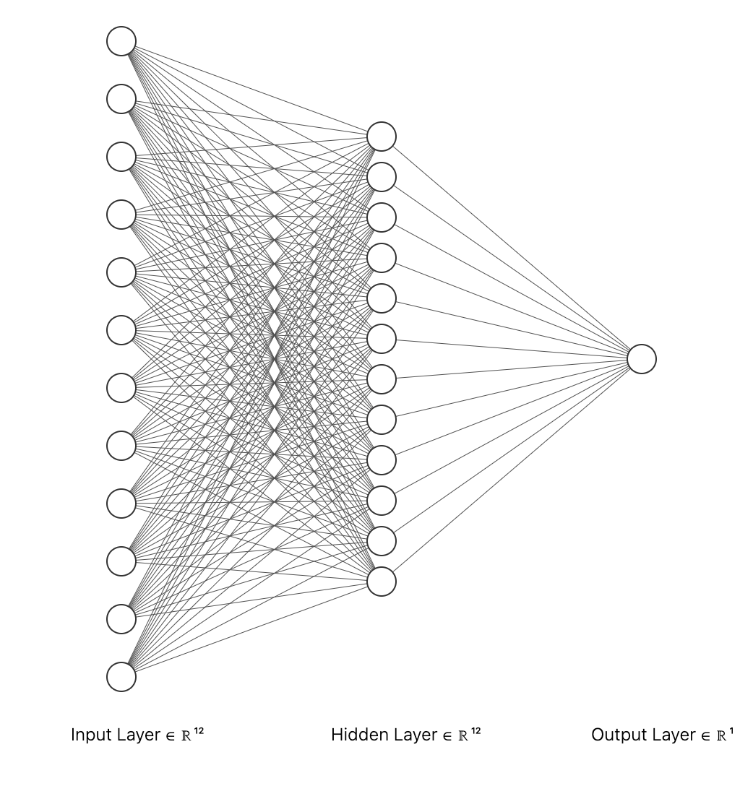
Notes:
http://alexlenail.me/NN-SVG/index.html
Srikar

Slide 14
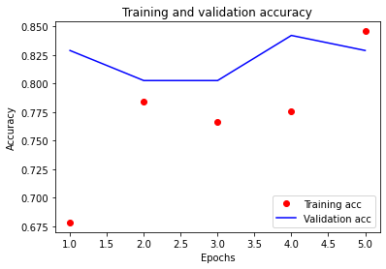
Notes:
Srikar

Slide 15
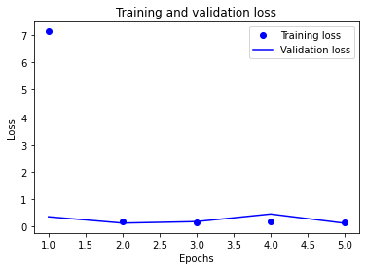
Notes:
Srikar

Slide 16
OVERFITTING
Notes:
Srikar

Slide 17
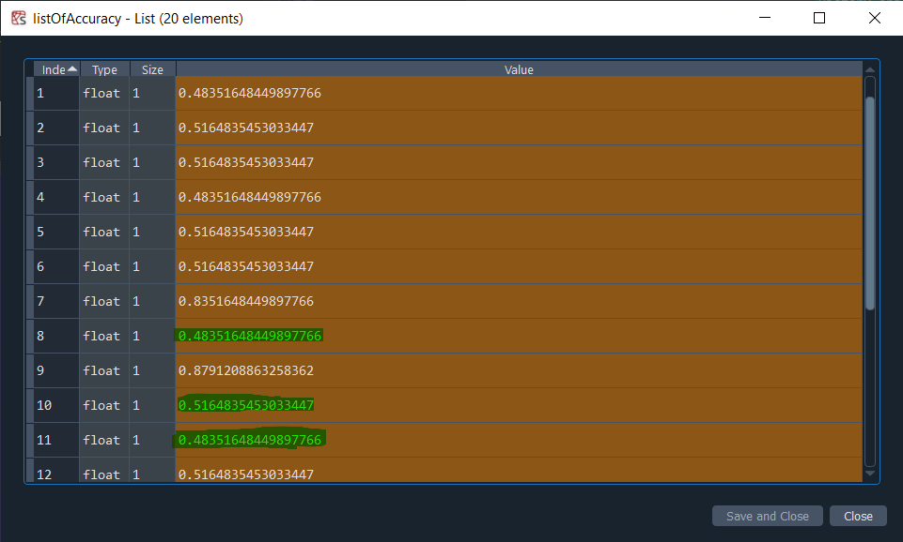
Notes:
Srikar

Slide 18
Correlations
Notes:
Srikar

Slide 19
Data meanings
Target:
1 is Yes(Red)
0 is No(Blue)
Notes:
Srikar

Slide 20
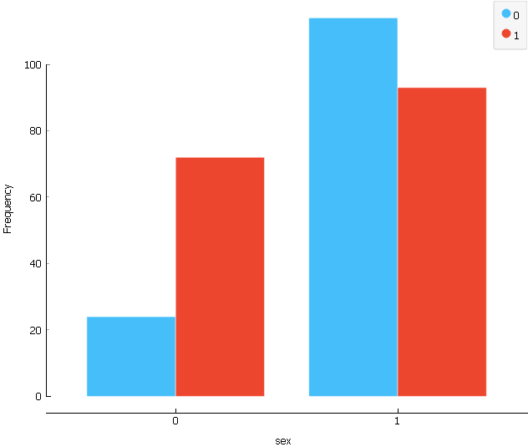
Gender vs Number of cases
Notes:
Ronit

Slide 21
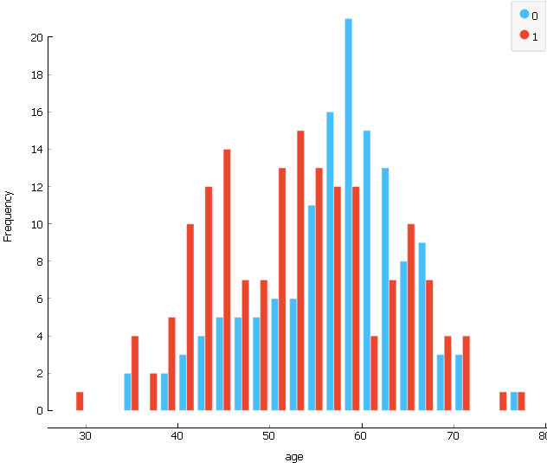
Age vs Number of cases
Notes:
Ronit

Slide 22
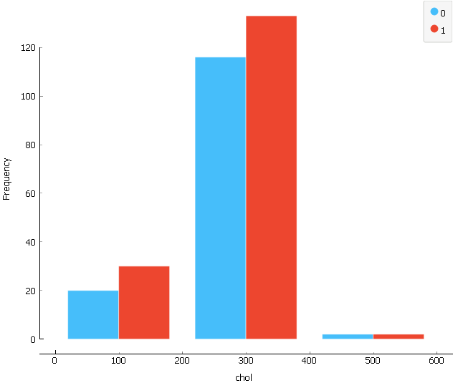
Cholesterol vs Number of cases
Notes:
Ronit

Slide 23
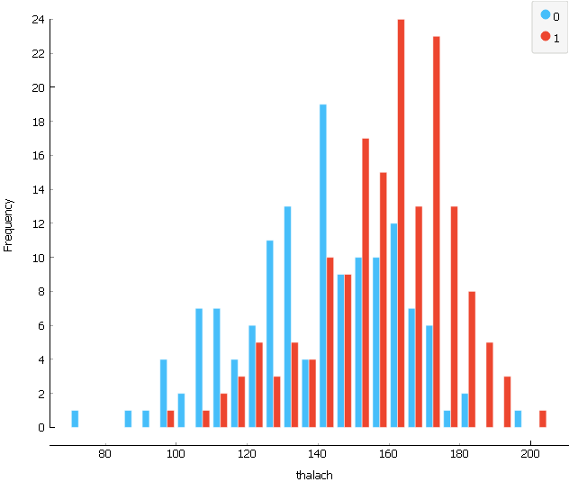
Maximum Heart rate vs Number of cases
Notes:
Ronit

Slide 24
Conclusion
More common in people under 60
Males more likely
Cholesterol of 200-400
Maximum Heart Rate of 150-180
Many false alarms
87% average accuracy
96% peak accuracy
Least important features
Fasting blood pressure
Angina
Notes:
Ronit

Slide 25
Questions?
Notes:
Srikar

Slide 26
Sources
Introduction Images:
https://images.ctfassets.net/yixw23k2v6vo/2gmXzt47usTgvqBdGsZthG/14b99ab35cd6d18930f5a0b02c4829d6/HEART_INFO_stas.png
https://www.heart.org/-/media/Data-Import/images/1/2/B/1208-news-mortality_Graphic.jpg

